Slide 1
CSC312
Searching

Slide 2
Searching
One of the early techniques adopted to solve AI problems (Watson, 2008)
Involve defining state spaces and using search algorithms to define and explore search trees in this state space
  State space: Collection or set of all possible states | situations in the problem of interest
  Usually defined by a set of variables where a state is the allocation of specific values to those variables
Example: In a car park with 10 parking spaces, if we have one state variable (noCars), then the number of possible states is 11
  We can also have 10 state variables one for each slot. And each variable taking 2 values (empty or filled)

Slide 3
Searching
If the number of different, distinguishable world situations is sufficiently small, a graph representing all possible actions and situations can be stored explicitly (Nilsson, 1998)
The nodes represent the possible situations, the arcs represent the possible actions that change the state from the current state to the state into which the arc is incident upon.
Such a graph of world models and actions is called a state-space graph
Searching involves finding a path in the graph from one of the nodes specified as the start node, to one of the nodes specified as the goal node
Graph search algorithms are usually used for this purpose

Slide 4
Searching
Example: Construct a state-space graph for the blocks world problem
  Blocks A, B, C initially all placed on the table
  State changed by stacking the blocks on top of each other or on the table one at a time
  Possible goal state blocks stacked on each other with A on the table, B on A, C on B
The actions along the path from the start state to the goal state are the sequence of actions that would be taken to achieve the goal state from the specified start state.
Such a sequence is called a plan
Remember 2 possible representations of a graph are an adjacency matrix and an adjacency list

Slide 5
Searching
Search trees consists of nodes that define locations, in state space and links to other nodes
  For some small problems, the search tree can be specified statically
  For many problems, this is not possible, hence search trees are specified implicitly so we define successor node search operators
    For a given node, this operator produces all the nodes that are reachable in one step from the current node

Slide 6
Searching
A node is used to represent a state (location) in the state space.
It can be implemented as an object in java
Nodes will contain a reference to the parent node, and an array of references to the children nodes
  A node that has no parent is the root node
  A node with no children is a leaf node

Slide 7
Searching
The state space for a grid kind of problem can be represented using a 2 dimensional array
  When the search space is specified in this way, search operators will move the point of reference (R) in the search space from a specific location to an adjoining grid location
    Move up
    Move down
    Move left
    Move right
  For some problems, diagonal movements are allowed

Slide 8
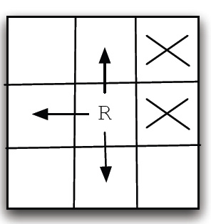
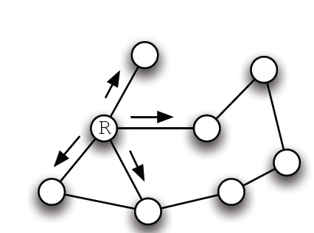
Searching
Example state spaces
Grid representation
State space graph

Slide 9
Searching
The state space for a grid kind of problem can be represented using a 2 dimensional array
  When the search space is specified in this way, search operators will move the point of reference (R) in the search space from a specific location to an adjoining grid location
    Move up
    Move down
    Move left
    Move right
  For some problems, diagonal movements are allowed

Slide 10
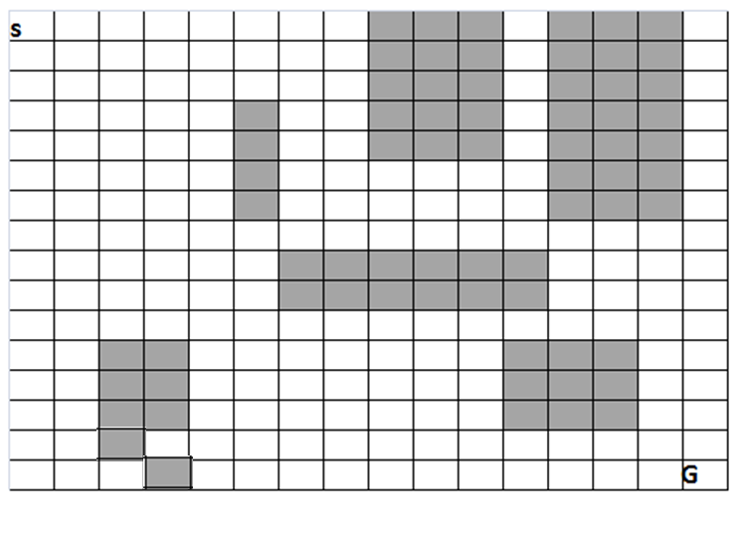
Finding Paths in Mazes
Usually, given a maze represented using a grid, we want to find a path from the start position to the goal location
Example Maze problem

Slide 11
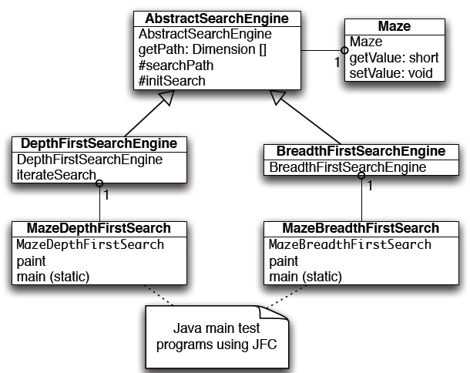
Finding Paths in Mazes
Class diagram for maze search java classes

Slide 12
Finding Paths in Mazes
The AbstractSearchEngine is the base class for both the DepthFirstSearchEngine and BreathSearchEngine classes
Depth first uses a stack to store moves that will be tried
Breath first uses a queue
The AbstractSearchEngine class
  The constructor requires 2 arguments to define the width and the height of the maze
    The constructor also defines an instance of the maze class
  It has a member array searchPath of type Dimension used to record the path traversed through the maze
  Dimension is a java class that has 2 integer data components

Slide 13
Finding Paths in Mazes
The base class also defines the following two utility methods
  equals(Dimension d1, Dimension d2) – returns true if the 2 dimension objects are equal
  getPossibleMoves(Dimension d) -- returns an array of dimension objects that can be moved into from the specified location
The Maze Class
  The constructor of this class will require 2 integers specifying the width and the length
  The position of the obstacles should also be specified.
  It may also have a method that given a position, it returns true if the position contains an obstacle
  It also contains the coordinates for the starting position and the goal position

Slide 14
Finding Paths in Mazes
The DepthFirstSearchEngine class
  This class calls the base class constructor then solves the search problem by calling the method iterateSearch
  The arguments to the iterateSearch method specify the current location and the current search depth
The iterateSearch method is found at depth-first.pdf
Questions
  Does the searchPath array contain the path to the goal
  Does the procedure always find the goal?
  Does it find the shortest path?
  Can a node be expanded more than once?
  Could it have been implemented without recursion?

Slide 15
Finding Paths in Mazes
The BreathFirstSearchEngine class
  This class uses the method doSearchOn2Dgrid to perform the search
  This method is not recursive
  It uses the queue object of type DimensionQueue class to store future positions from which the search be extended
  It uses a two dimensional array allReadyVisited which stops us from visiting the same location twice
  The array predecessor is used to get the path that was used to reach the goal
  The details can be found here

Slide 16
Graph Search
For graph search, the state space is represented by a graph
A graph is a set of nodes and links
Nodes have the following features
  A name
  Zero or more links (edges) to other nodes
  A spatial position -- (x, ) coordinates in case visual representation is required
For graph search, a movement operator allows movement to another node if there is a link to the target node

Slide 17
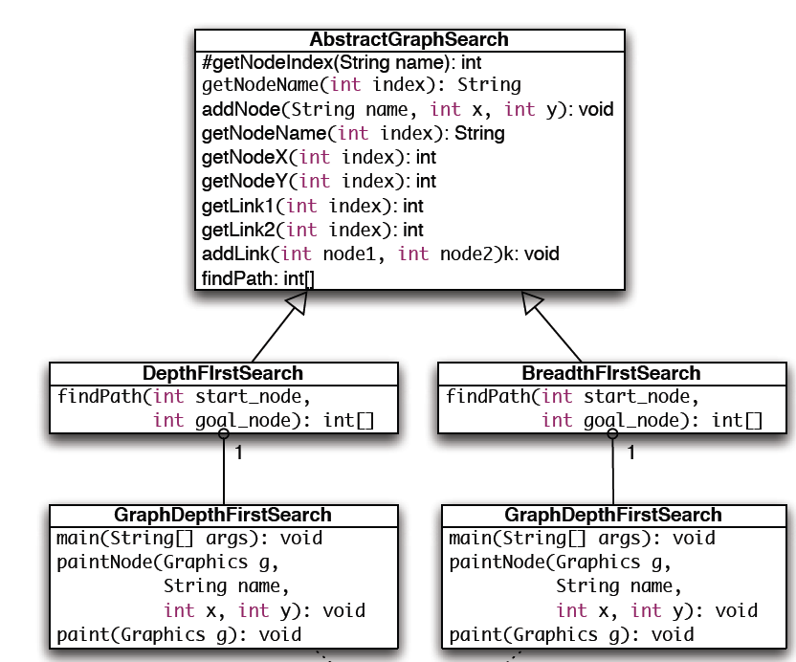
Graph Search
Graph Search Classes

Slide 18
Graph Search
Most of the Graph manipulation methods are implemented in the base class
Member Variables include
final public static int MAX = 50;
protected int [] path =
new int[AbstractGraphSearch.MAX];
protected int num_path = 0;
// for nodes:
protected String [] nodeNames =
new String[MAX];
protected int [] node_x = new int[MAX];
protected int [] node_y = new int[MAX];
= -1;

Slide 19
Graph Search
// for links between nodes:
protected int [] link_1 = new int[MAX];
protected int [] link_2 = new int[MAX];
protected int [] lengths = new int[MAX];
protected int numNodes = 0;
protected int numLinks = 0;
protected int goalNodeIndex = -1,
startNodeIndex = -1;

Slide 20
Graph Search
The abstract method findPath is used to do the searching and must be overridden by the subclasses
For the DepthF irstSearch class, the overriding method is discussed here
Questions
  Can the method be implemented without recursion?
  Would representing the links using an adjacency matrix make the program easier
  check out the connected_nodes method in the code file. Does it prevent revisiting of already encountered nodes? How?

Slide 21
Graph Search
The BreathF irstSearch class also overrides the findpath method
The overriding method is discussed here
Notes on Graph Search
For all but small problems, memory requirements for breath first search become prohibitive
Breath first search is guaranteed to find the goal node at the shallowest depth
Iterative deepening search can be used together with depth-first search to ensure that the shallowest goal is found
Heuristic search algorithms are graph search algorithms which have domain specific heuristic (evaluation function) which is used to decide the next node to expand. This is also called best-first search. An example is the A* algorithm

Slide 22
Graph Search
Programming Problem
A road network will consist of
  Roads
  Junctions
  Roundabouts
Junctions and roundabouts can be considered as the nodes
The sections the nodes are the links
Needed
A visual representation of your road network
Implementation of a solution using graph search that enables the user to find a path from any junction/roundabout in the network to any other junction/round about
Creativity will be rewarded ; Similar solutions will incur penalties ;

